Slide 1

Restarunt System

Slide 2
Ahmed Emad Elsherbini Ali
Ahmed Hany Abdelrazek
Kholoud Mohamed Sobeh
11
Team
Members
17
38
Marwa Mohamed Ahmed
Maryam Saied Mostafa
Zeinab Ahmed Younes
44
88
89

Slide 3
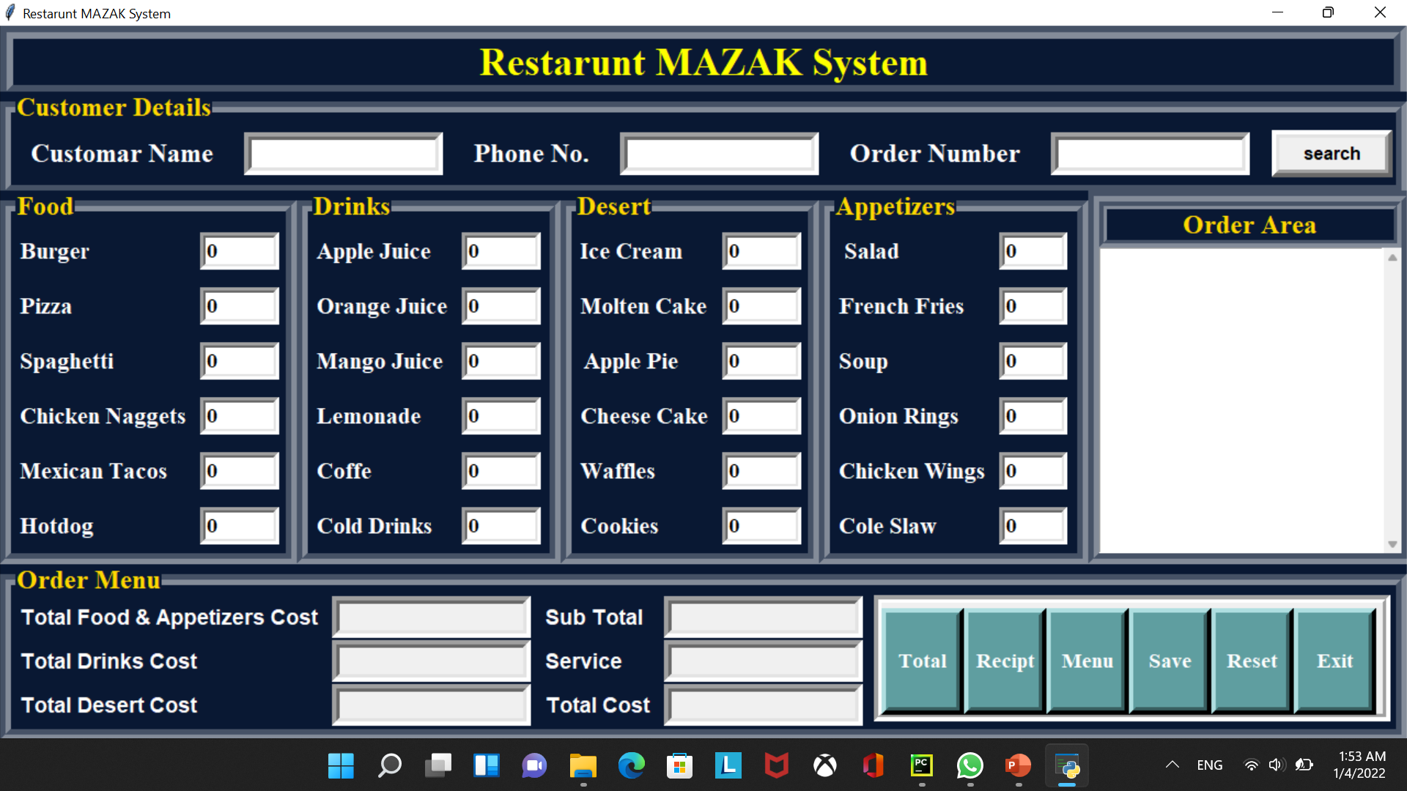
Main Badge
Display System

Slide 4
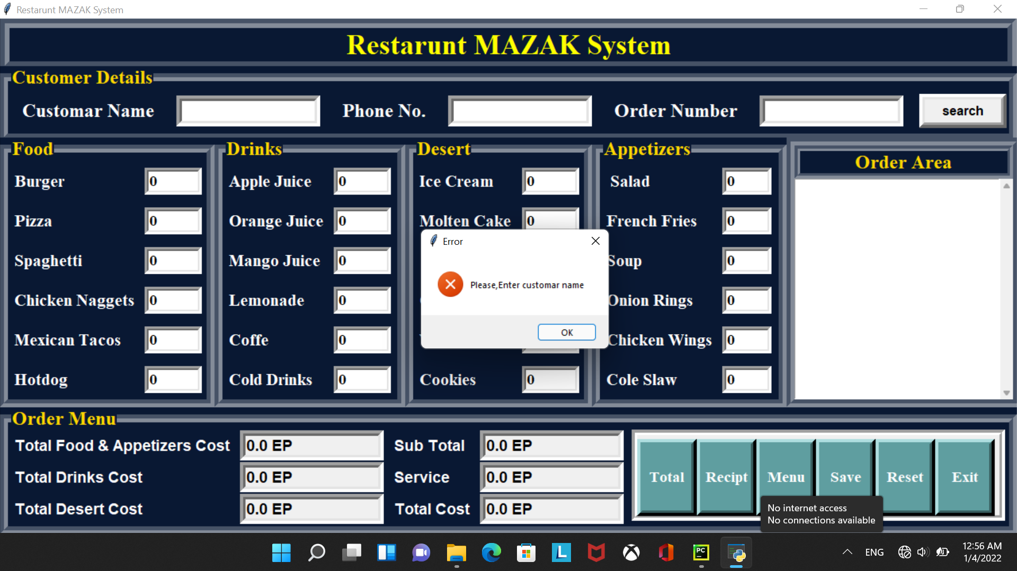
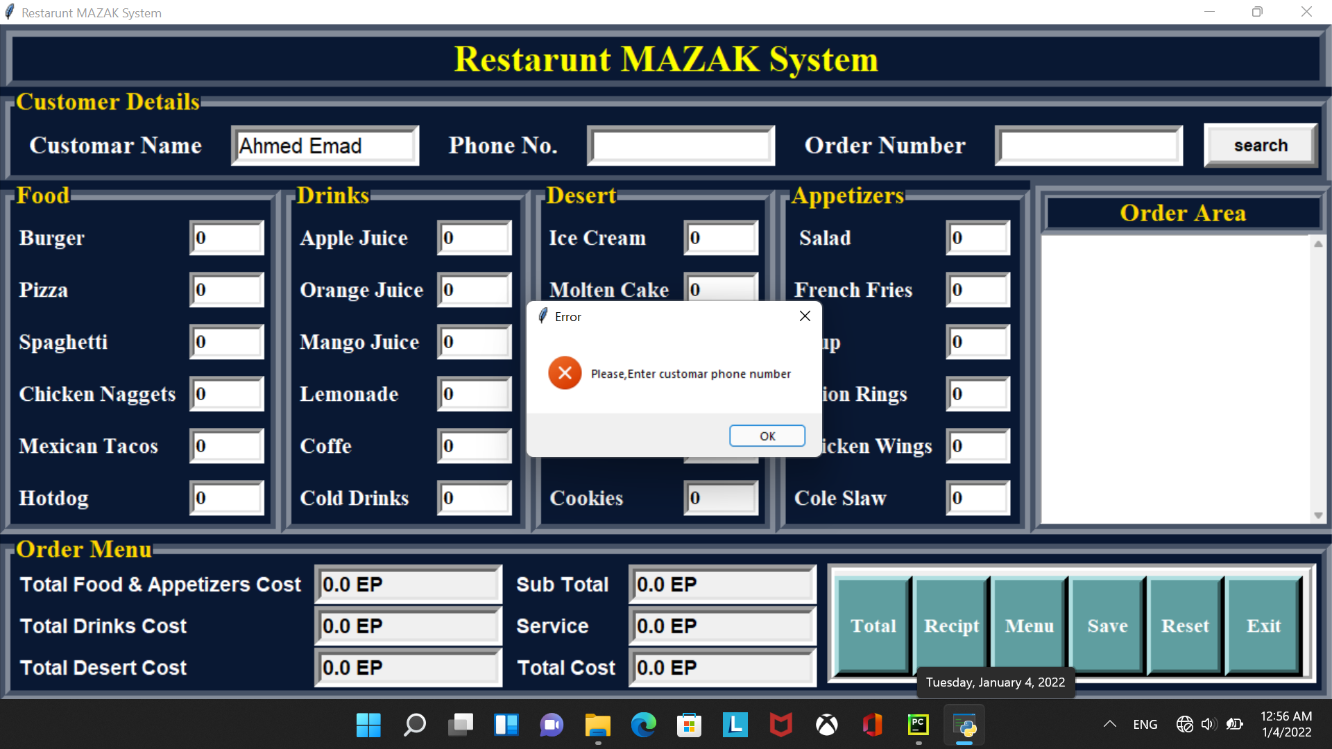
Customar Data
Customar Data
Check Enter the name or not
Check Enter the number or not

Slide 5
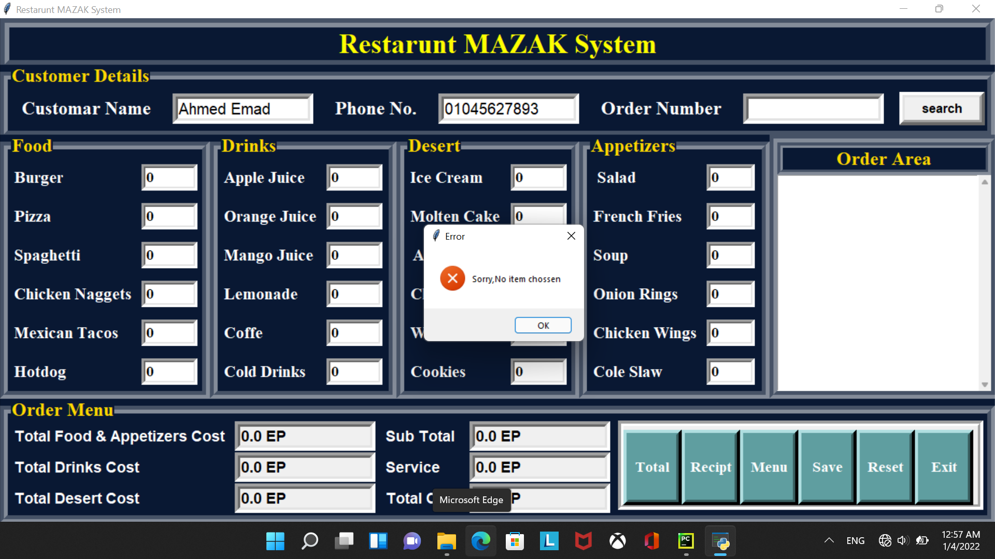
Customar
Customar Data
Check that at least one item was chosen

Slide 6
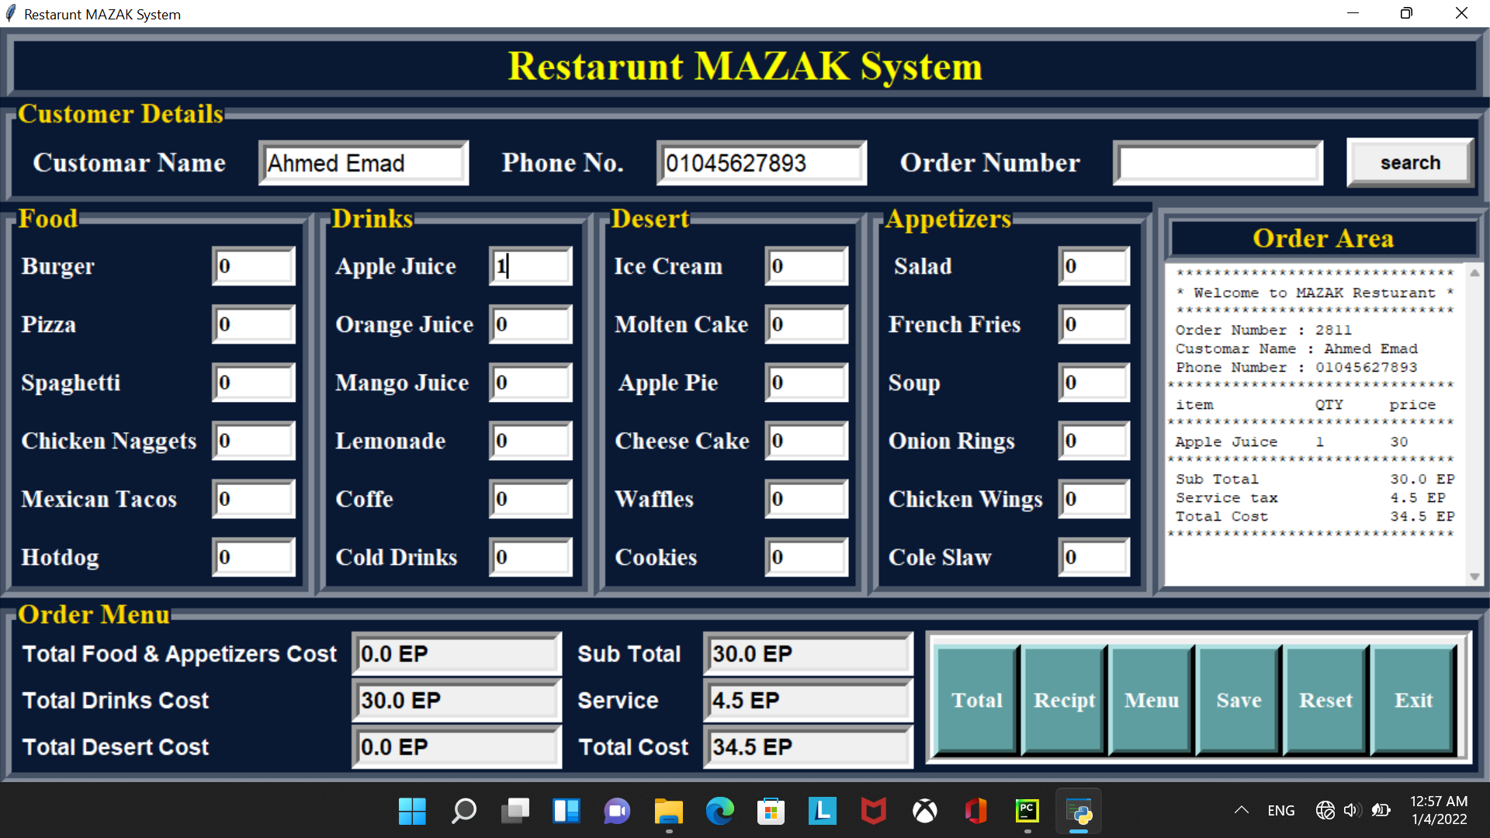
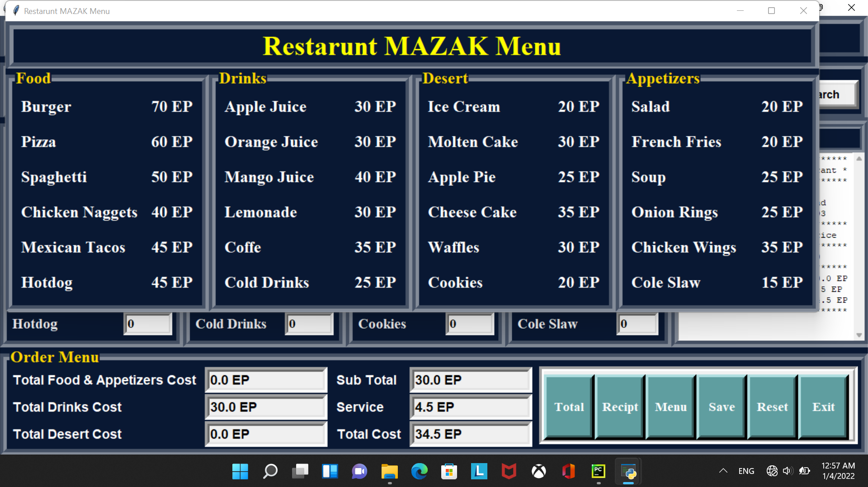
Recipt
Menu

Slide 7
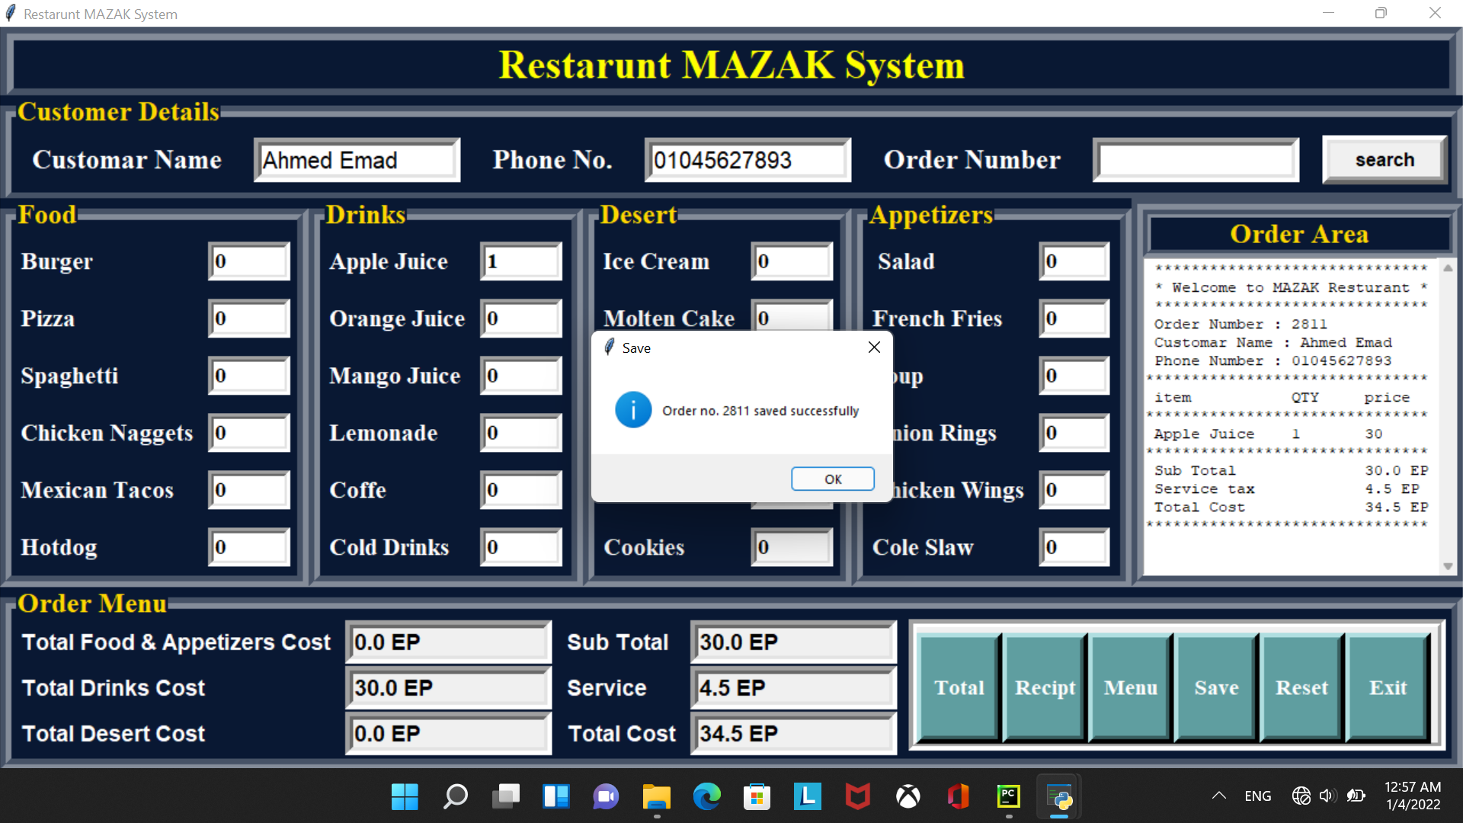

Save Order Successfully

Slide 8


Exit
Search

Slide 9
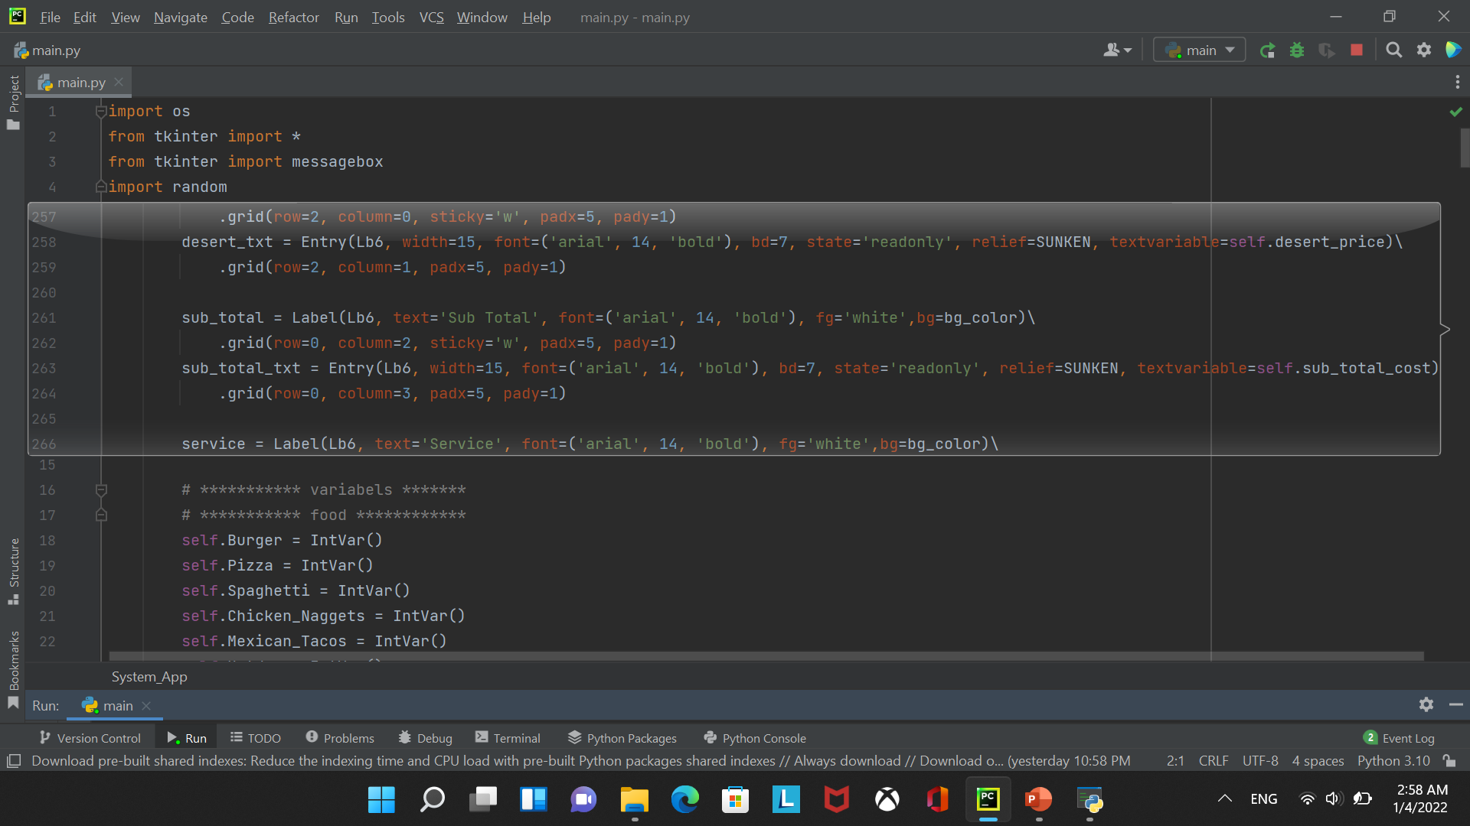
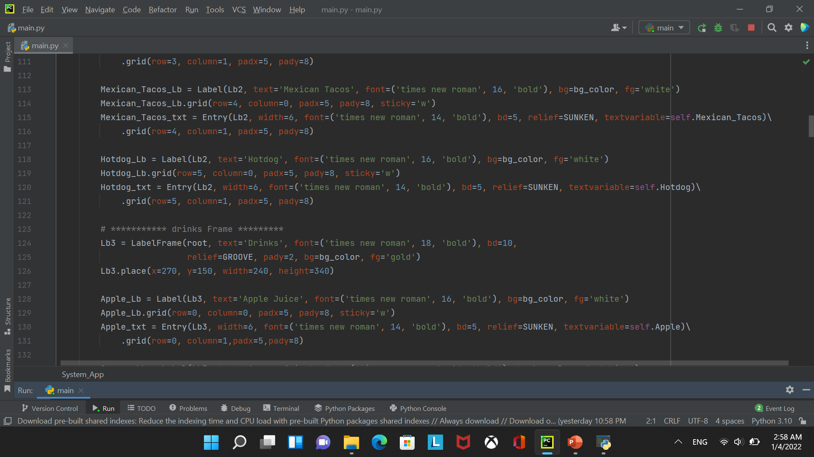
Some Screen Shoot From Code

Slide 10
